Slide 1

Burn Wound Imaging Classification
Data7901 Frontier Project Seminar
Week 13, S1, 2021
Xinqian Wang, 45654897, supervised by Dr Mahsa Baktashmotlagh
Project Definition: developing a system for burn wound recognition that helps to classify the categories of burn wounds

Slide 2

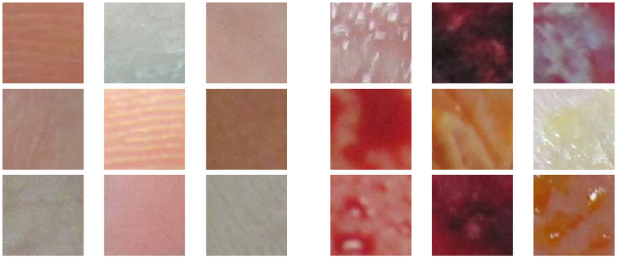
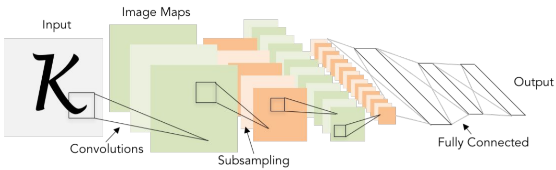
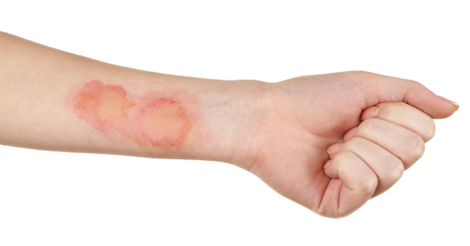
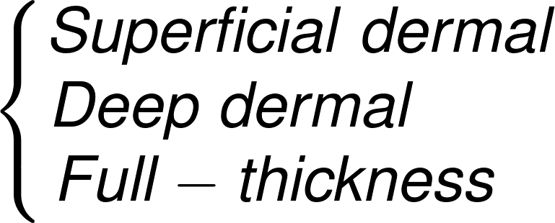
page-1
Workflow
Feature Extraction
Skin
Burn

Slide 3
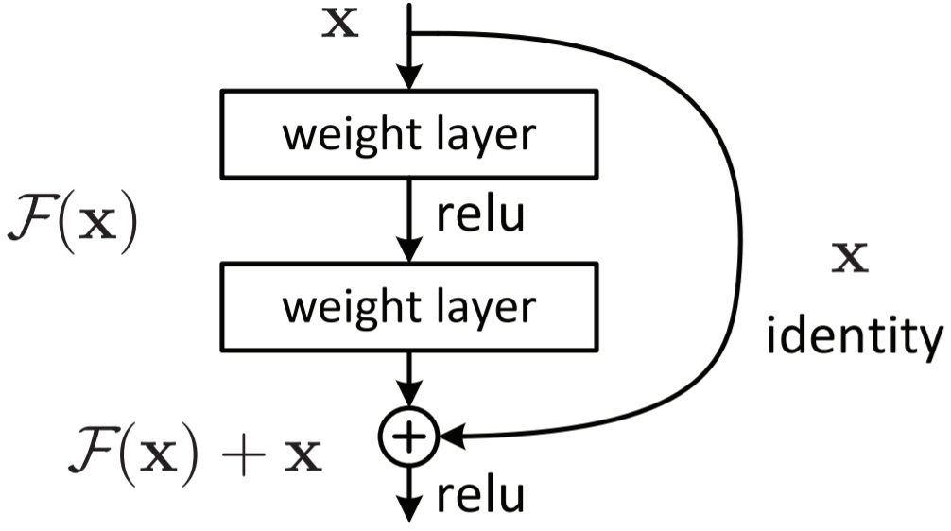
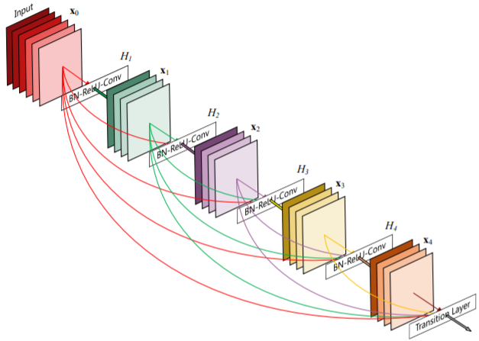


page-2
Approach
Image Pre-processing
Model
Testing
Network
6
ResNet
1
5
Data Augmentation
Model
Validation
DenseNet
2
4
Network Building
Model Training
3
Programming
Transfer Learning and Domain Adaptation may also involved during the Network Building.

Slide 4


page-3
Datasets
Herston Biofabrication Institute (HBI) is the key partner of one health services provider which is called the Metro North Health. HBI receives 3000-3500 referrals per year.
We have achieved the samples of 84 burn wound images.
The dataset contains 3 different burn types, Superficial dermal, Deep dermal, and Full-thickness. 20 images in training set and 74 images in testing set.
Acknowledgement: This database belongs to the Biomedical Image Processing (BIP) Group from the Signal Theory and Communications Department (University of Seville, SPAIN) and Virgen del Rocío Hospital (Seville, SPAIN) .
Public Datasets
Privacy Issues
Must be careful when utilizing the burn wound images and not allowed to share with others.
(for example, some images may appear tattoos, which is very sensitive when corresponding to identify a person.)

Slide 5
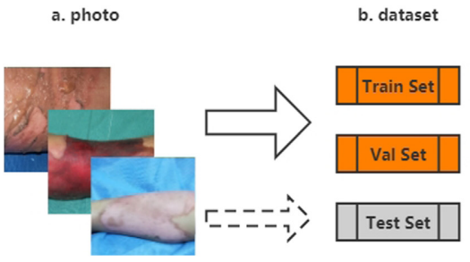
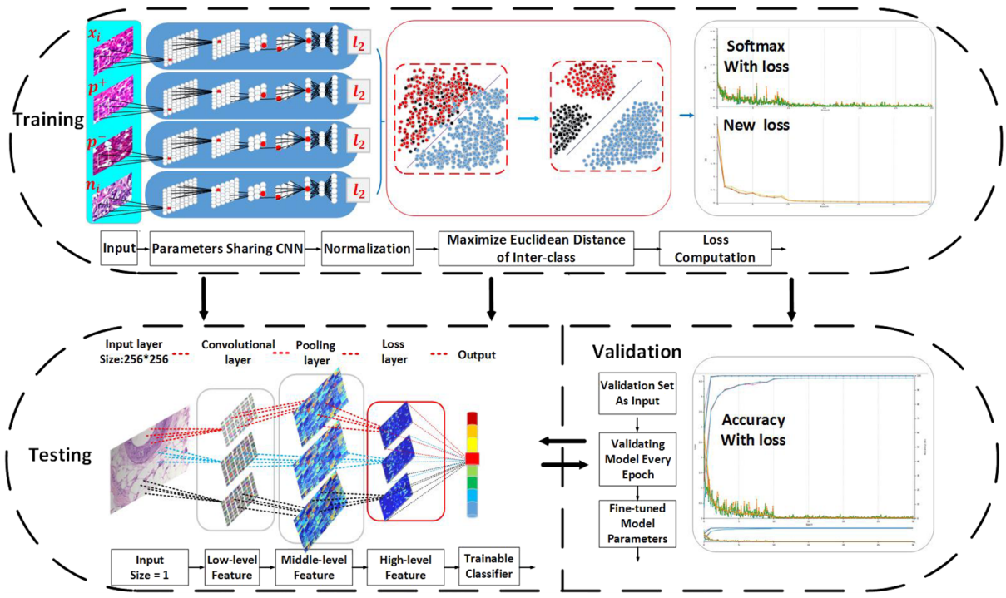
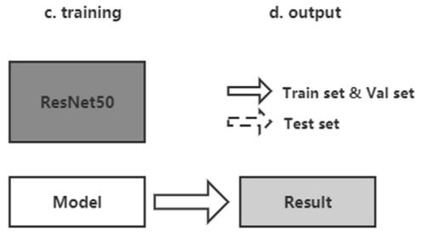


page-4
Related Works
[Han et al., 2017]
Breast cancer multi-classification
based on GoogLeNet
[Wang et al., 2020]
Burn depth multi-classification
using ResNet50

Slide 6
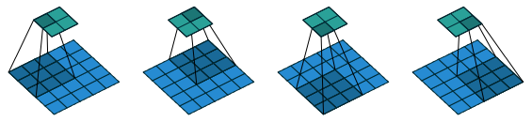
page-5
Motivation and Conclusion
Feasibly,
The burn wounds’ depth and type can be accessed through color, moisture and whether there exists blisters, which is just the advantages of Computer Vision Technologies. (for example, the deeper the burn is, the more paler it would be.)
Potentially,
By achieving our objective, we can Improve the efficiency and accuracy of early clinical diagnosis.
Finally,
The success of the project would make huge contributions for the domain of Medical Image Analysis. It will encourage our researchers to keep working on and saving more lives.

Slide 7

Thanks for attending my presentation

Slide 8
Reference
Dumoulin, Vincent, & Visin, Francesco. (2016).
Han, Z., Wei, B., Zheng, Y., Yin, Y., Li, K., & Li, S. (2017). Breast Cancer Multi-classification from Histopathological Images with Structured Deep Learning Model. Scientific Reports, 7(1). https://doi.org/10.1038/s41598-017-04075-z
He, Kaiming, Zhang, Xiangyu, Ren, Shaoqing, & Sun, Jian. (2016). Deep Residual Learning for Image Recognition. 2016 IEEE Conference on Computer Vision and Pattern Recognition (CVPR), 2016, 770-778.
Khademi, Gholamreza, Mohammadi, Hanieh, & Simon, Dan. (2019). Gradient-based multi-objective feature selection for gait mode recognition of transfemoral amputees. Sensors (Basel, Switzerland), 19(2), 253.
Ma, Hui, & Celik, Turgay. (2019). FER-Net: Facial expression recognition using densely connected convolutional network. Electronics Letters, 55(4), 184-186.
Şevik, U., Karakullukçu, E., Berber, T., Akbaş, Y., & Türkyılmaz, S. (2019). Automatic classification of skin burn colour images using texture‐based feature extraction. IET Image Processing, 13(11), 2018–2028. https://doi.org/10.1049/iet-ipr.2018.5899
Wang, Y., Ke, Z., He, Z., Chen, X., Zhang, Y., Xie, P., . . . Kai, L. (2020). Real-time burn depth assessment using artificial networks: a large-scale, multicentre study. Burns, 46(8), 1829–1838. https://doi.org/10.1016/j.burns.2020.07.010

